Slide 1
Modal auxiliary verbs

Slide 2
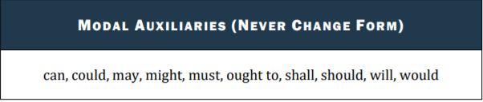
modal AUXILIARY VERBS
These verbs are used to indicate and express possibility, probability, ability, permission, obligation, certainty, willingness, necessity etc.

Slide 3

Modal auxiliary verbs are never used alone. A primary verb is either implied or present.
He will come. (will- modal auxiliary, come- primary/ main verb)
Modal verbs do not have infinitives or –ing forms
The modal auxiliaries do not change their form, whatever be the number and person of the subject.
I can write. You can write. They can write. We can write. She can write.

Slide 4
Modal verbs use other verbs to complete the tenses.
Can is completed with be able to.
Must is completed with have to .
You must come early- You have to come early.

Slide 5
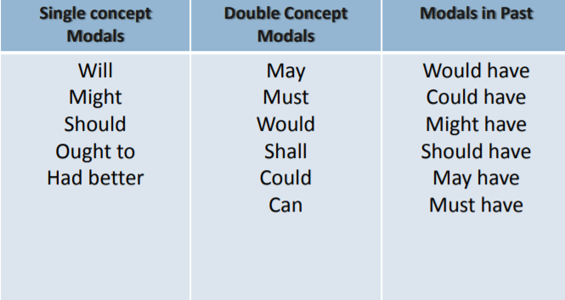

Slide 6
USES OF WILL
To denote future action- We will go to the movie tonight.
to make a polite request- Will you join me for lunch? / Will you be quiet!
to make a prediction -If she receives a scholarship, she will continue with her studies.
USES OF WOULD
Past of will- You said we would go to the movie.
Conditional- If I were in trouble, I would ask him for help.

Slide 7
USES OF MAY & MIGHT
USES OF MAY
To make a formal request -May I speak with you in my office?
To request permission- May I leave class early today?
To show possibility- I may want to schedule at least one more appointment.
to make a prediction If we cooperate with the opposition, it may be to our advantage.
USES OF MIGHT
Conditional- If you give me a chance, I might impress you!
Might is often used in polite suggestions.
You might like to read this and see what you think.

Slide 8
Use “may” when something is more likely to happen.
Use “might” if something is less likely to happen or in a hypothetical situation.
Both may and might are used to express the possibility of some future action; might is more tentative than may.
The weather may/might be better tomorrow.

Slide 9
Uses of can & could
USES OF CAN
to show or infer general ability- I can lift this.
to make a polite or an informal request -Can you come early tomorrow?
to give permission- You can have a break.
Possibility (usually a generalization)-It can be tiring to study and work at the same time.
USES OF COULD
Past of can-
Conditional -I could have made an omelet if we had the ingredients.
Suggestion- You could have taken a long weekend.
Polite Request- Could you buy me a pair of gloves?
Possibility- Ms. Stevens could be the electors’ choice for mayor.

Slide 10
Uses of shall/ should
USES OF SHALL
to show intention- We shall overcome.
to make a polite or informal request- Shall I open it for you?
Inevitability- Humanity shall never abandon the quest for immortality.
USES OF SHOULD
Recommendation- For strong bones, you should drink milk.
to infer responsibility or obligation- We should work together to protect the environment

Slide 11
Uses of must
to indicate necessity - You must respond as soon as possible.
Strong recommendation- To be healthy, you must eat well.
Certainty- She must be the best athlete in our school’s history.
Have to mainly expresses general obligations, while must is used for specific obligation
MUST is used when expressing obligation or an unavoidable requirement, whereas SHOULD is more of a recommendation, or simply a desirable goal.

Slide 12
MODALS IN CONDITIONAL STATEMENTS
Modal auxiliary verbs are also used to distinguish realistic or possible conditions from the unrealistic, imaginary, or impossible.
If I want to see you tonight, I will call you.
If you are not keeping well, you should take medicines.
To express unrealistic or imaginary situations or conditions contrary to fact in the present, use “would,” “could,” “should,” or “might.”
If I were rich, I could quit my job.
If I won the lottery, I would give you a million dollars.

Slide 13
To express conditions in the past that did not occur, special modal forms are used: “would/could/should/might have” plus the participle.
If you had given me the money, I would have paid the rent on time.
If I had known you would be late, I could have taken the bus.

